Slide 1
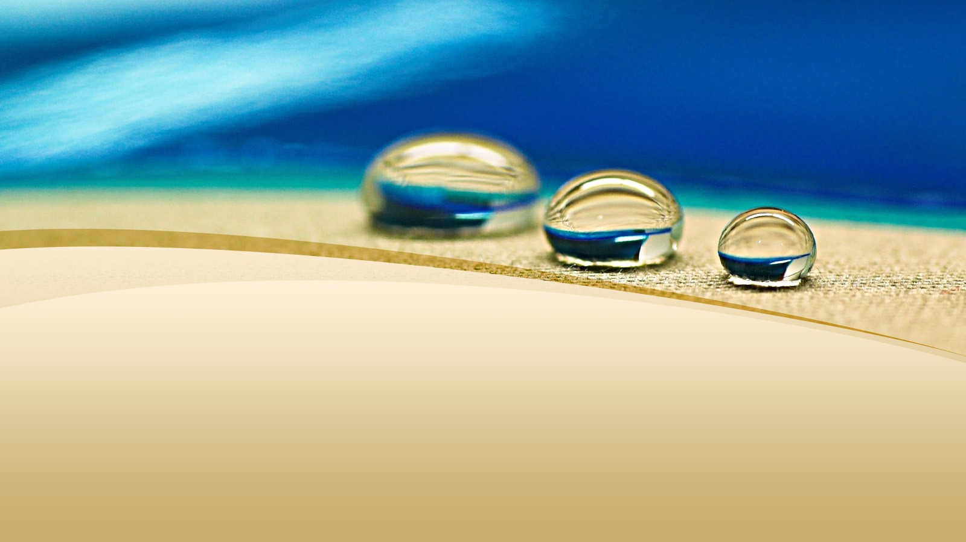
Department of Third Year Session 2021-2022 Semester V Branch IT Subject:- Topic of Presentaion :- Necessity of water treatment plant
Water Treatment Plant
Presented by:-
Samir bante IT56
Yash thakur IT54
Yash samarth IT55
Sumit Wakde
Shivam butle
Shoyeb Sheikh

Slide 2

WATER TREATMENT PROCESS AIM
A Water Treatment Plants aim to ensure that water is:
♦ Safe for human consumption
♦ Pleasant to consumers
♦ Provided at a reasonable cost

Slide 3
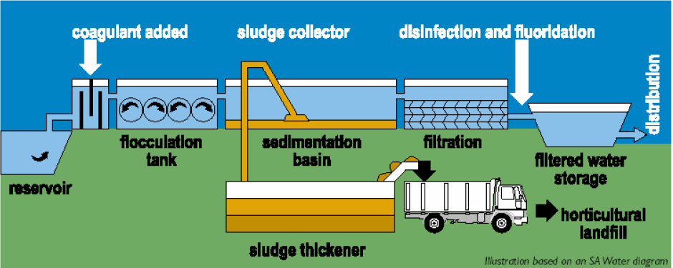
WATER TREATMENT PROCESS

Slide 4
HISTORY OF WATER TREATMENT COMPANIES
Filtration was established as an effective means of removing particles from water and widely adopted in Europe during the eighteenth century.
The water treatment processes developed in the 19th century and refined during the 20th century are simple in nature.

Slide 5
WHY TREAT WATER?
The aim of water treatment is to remove contaminants or reduce them to a concentration that means the water is safe to drink. Safe drinking water does not have to be sterile, and can contain organic and inorganic matter that the body can tolerate.

Slide 6
The Essential Steps in High Quality Water Treatment
COAGULATION
FLOCCULATION
FILTRATION

Slide 7

DISCUSSION
1. Why do you think it is necessary to treat water for drinking?
Treating water is an important process in maintaining a healthy society. The treatment of water removes germs and viruses from the water that can cause disease and sickness in humans.
2. Can you identify which processes are the most important in treating drinking water?
All processes in the WTP are important however filtration is one of the most important processes as it cleans the water in an effective way.
3. Do you know where your water comes from (which WTP)?
Look on the Maps provided to see the closest WTP to your home.
industrial wastewater treatment

Slide 8
THE WATER CYCLE
1.Surface Water
♦ Lakes and Reservoirs
♦ Rivers and Streams
2.Groundwater

Slide 9
DIFFERENT TYPES OF PROCESSES
♦ Collection of water from the dam or reservoir
♦ Coagulant (Alum and Lime added)
♦ Flocculation Tank
♦ Sedimentation Basin or Tank
♦ Sludge Collection
♦ Sludge Thickening
♦ Storage of sludge, reuse and disposal
♦ Filtration
♦ Disinfection and Fluoridation
♦ Water Storage
♦ Water Distribution

Slide 10
Why is Water Quality Important?
Water resources are of major environmental, social and economic value to Country, and if water quality becomes degraded this resource will lose its value. Water quality is important not only to protect public health - water provides ecosystem habitats, is used for farming, fishing and mining, and contributes to recreation and tourism.
If water quality is not maintained, it is not just the environment that will suffer - the commercial and recreational value of our water resources will also diminish.

Slide 11
How is Water Quality Measured?
The presence of contaminants and the characteristics of water are used to indicate the quality of water. These water quality indicators can be categorised as:
Biological: bacteria, algae
Physical: temperature, turbidity and
clarity, colour, salinity, suspended
solids, dissolved solids
Chemical: pH, dissolved oxygen,
biological oxygen demand, nutrients
(including nitrogen and phosphorus),
organic and inorganic compounds
(including toxicants)
Aesthetic: odours, taints, colour,
floating matter
Radioactive: alpha, beta and gamma
radiation emitters

Slide 12
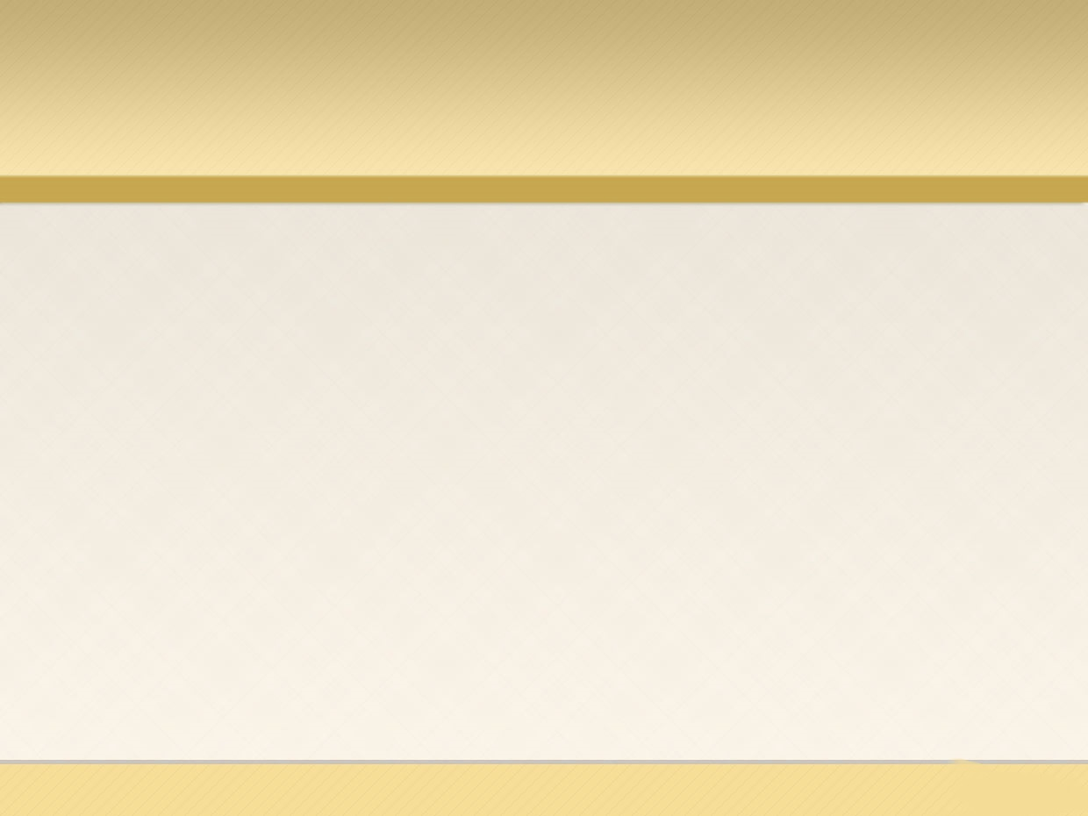
Water Treatment Plant Manufacturers
158/1B, SSM Dyeings Compound,
Murugampalayam, Iduvampalayam (PO)
Tirupur - 641687.
For more info: http://www.austrowatertech.com/

Slide 13
Thank you

